Slide 1
Hiding in Plain Sight
Capt Christian Wachter
OA3802

Slide 2
Problem
Electromagnetic environments are becoming increasingly crowded and complex.
Military, commercial, and personal civilian systems all operate across overlapping frequency bands, often at comparable power levels.
Conventional detection methods such as energy detectors or spectral analysis often face severe limitations in dense EM environments whether it is from low SNR conditions, co-channel interference, or noise-like modulation schemes.

Slide 3

Solution
Cyclo-stationary signal processing (CSP) is necessary because it exploits hidden, structured periodicities in signals that noise and interference lack.
In crowded or adversarial spectrum environments, this allows reliable detection, classification, and separation of signals that conventional energy or Fourier-based methods cannot resolve.

Slide 4

Methodology
Develop a simulation environment.
Scale the transmitters to hide the target UAV control link.
Stream the composite, raw I-Q signal into a database.
Estimate the Spectral Correlation Function.
Stand-up virtual HPC environment.
Observe signals with strong periodicity.
Train a classification model.
Build a cyclic filter to isolate the target signal.
Leverage CSP APIs.
Extract the target signal from the environment.

Slide 5
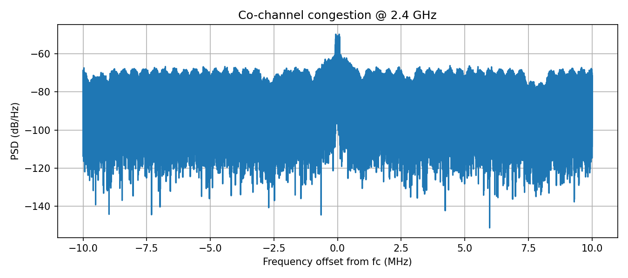
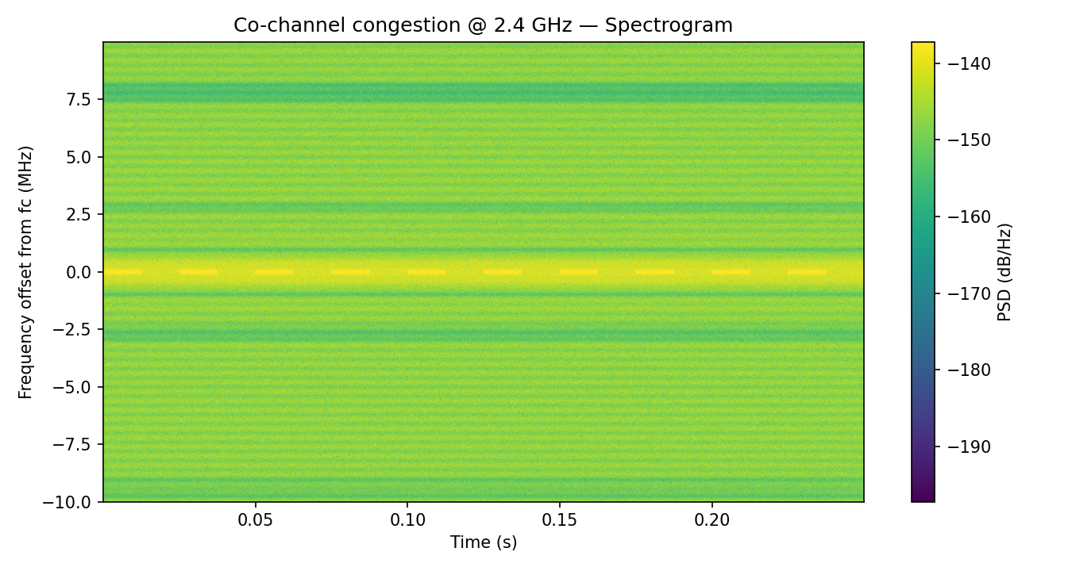
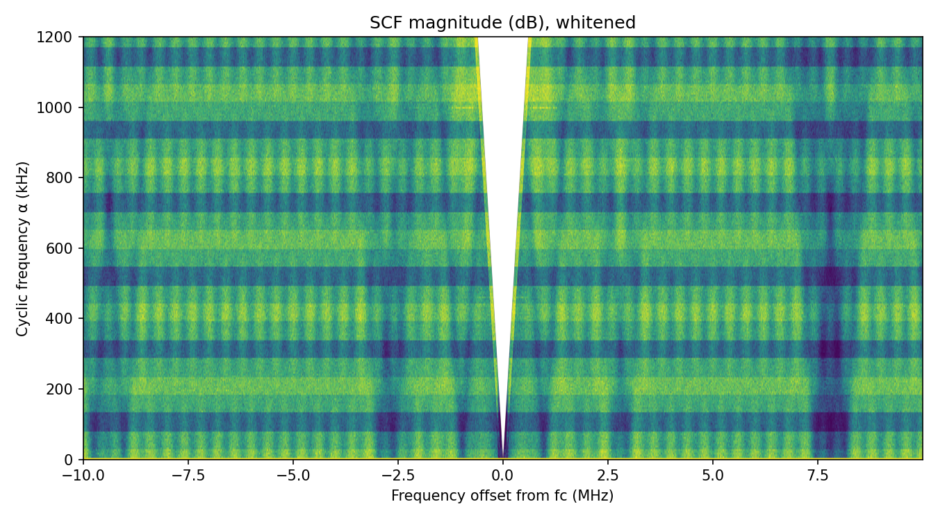
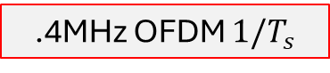
Quick-look
Three Signals + Noise
“Wi-Fi like” OFDM TCP/IP traffic
“Blue Tooth” GFSK data burst
“UAV link” DSSS-BPSK
1MHz DSSS chip rate
.4MHz OFDM $1/T_{s}$
Unused OFDM subcarriers

Slide 6
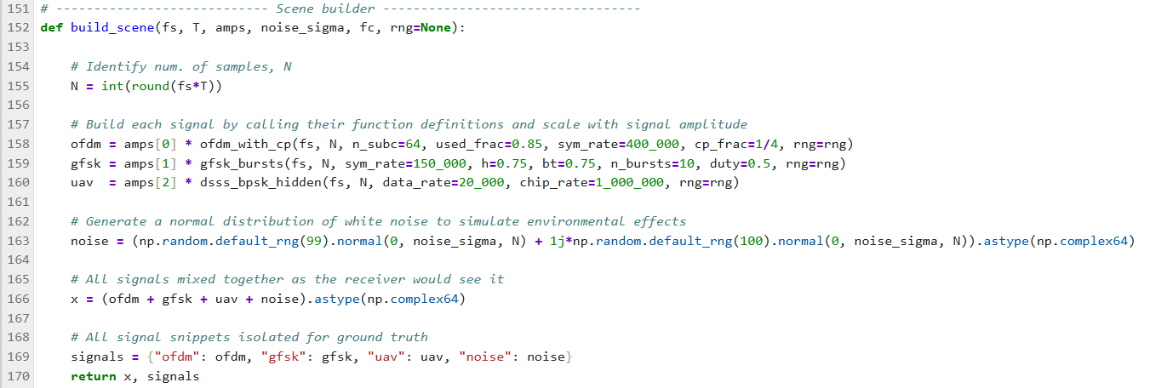
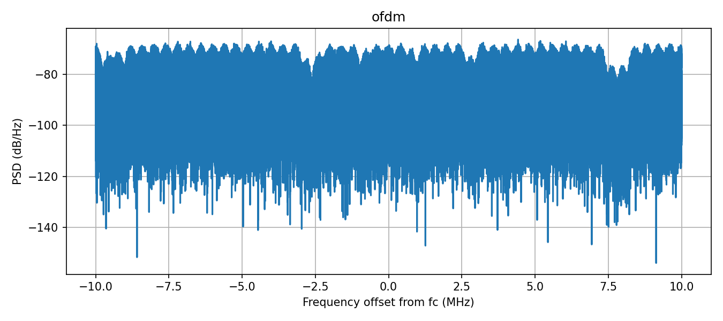
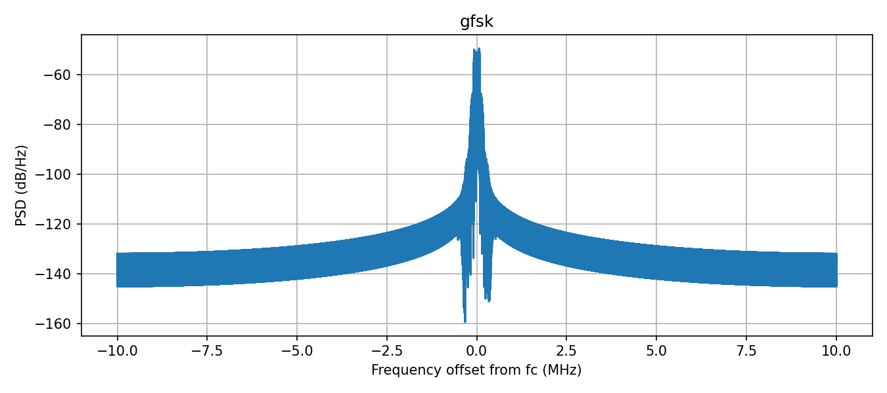
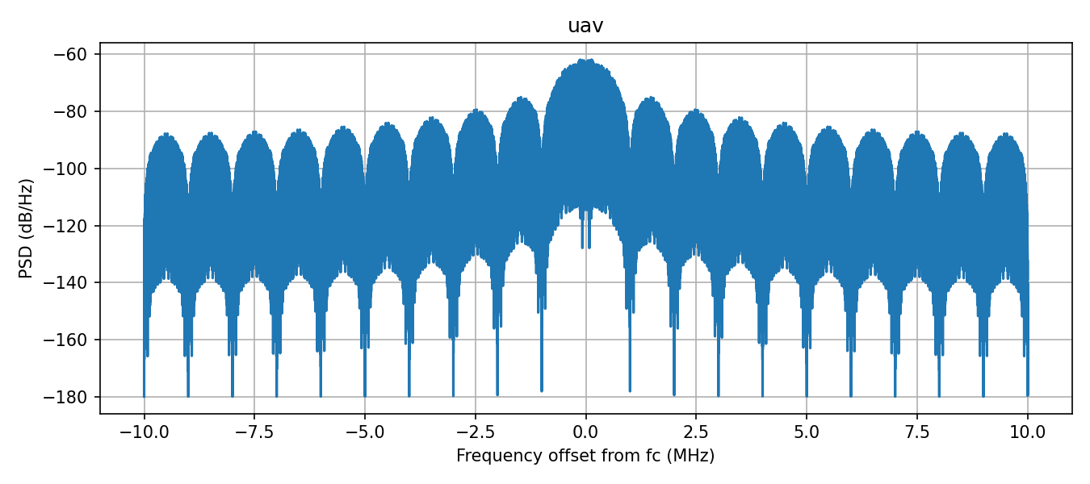
Build the scenario
Expected Cyclic features

Slide 7
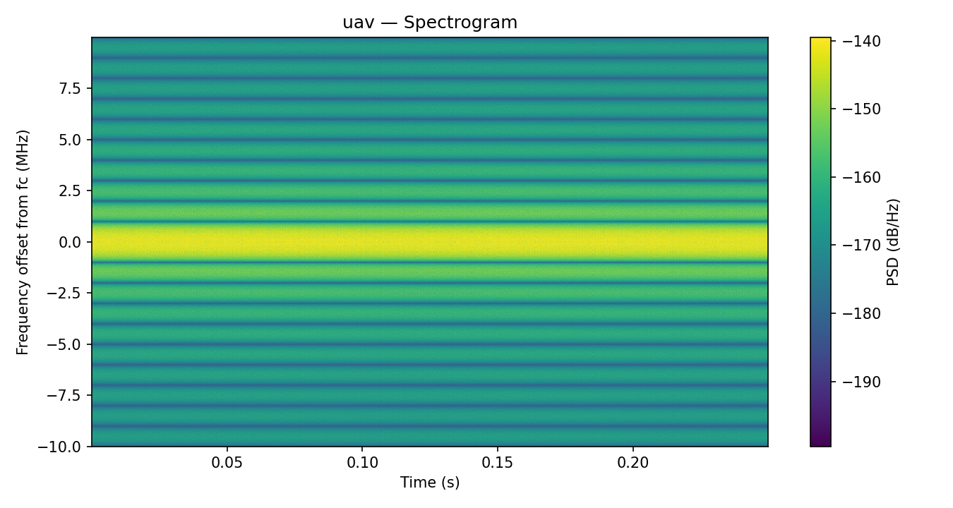
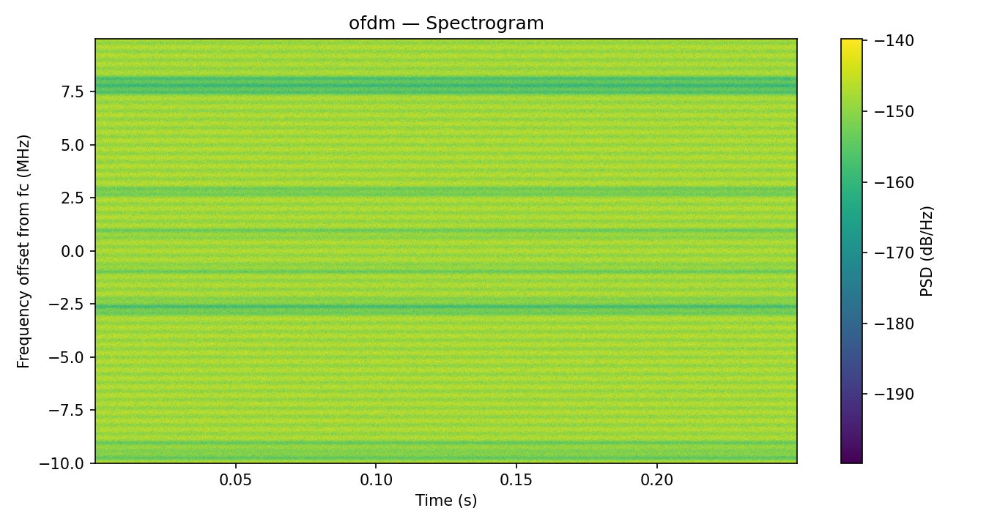
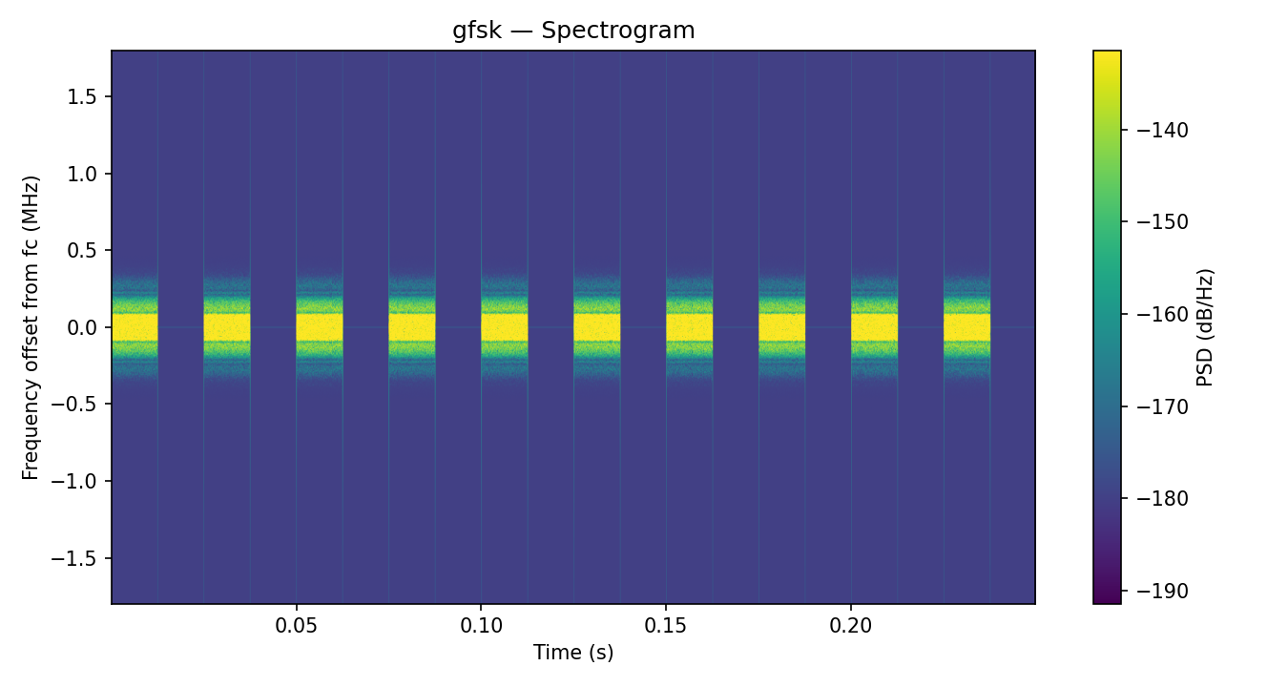
Scenario Cont.

Slide 8
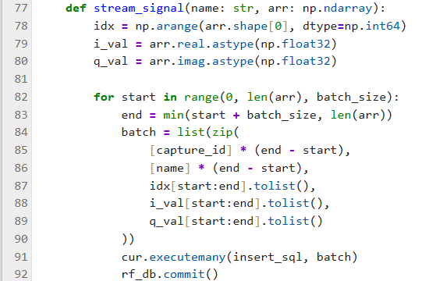
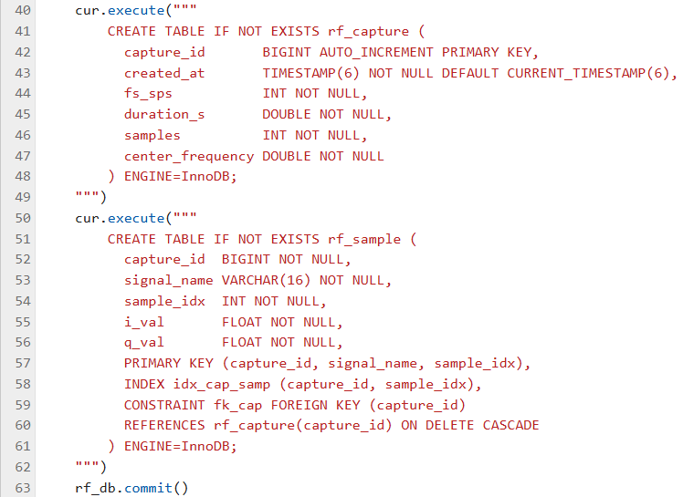
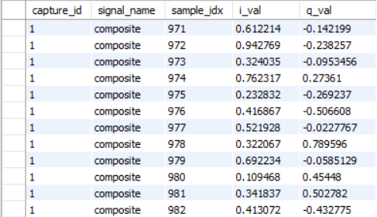
Stream to MySQL

Slide 9
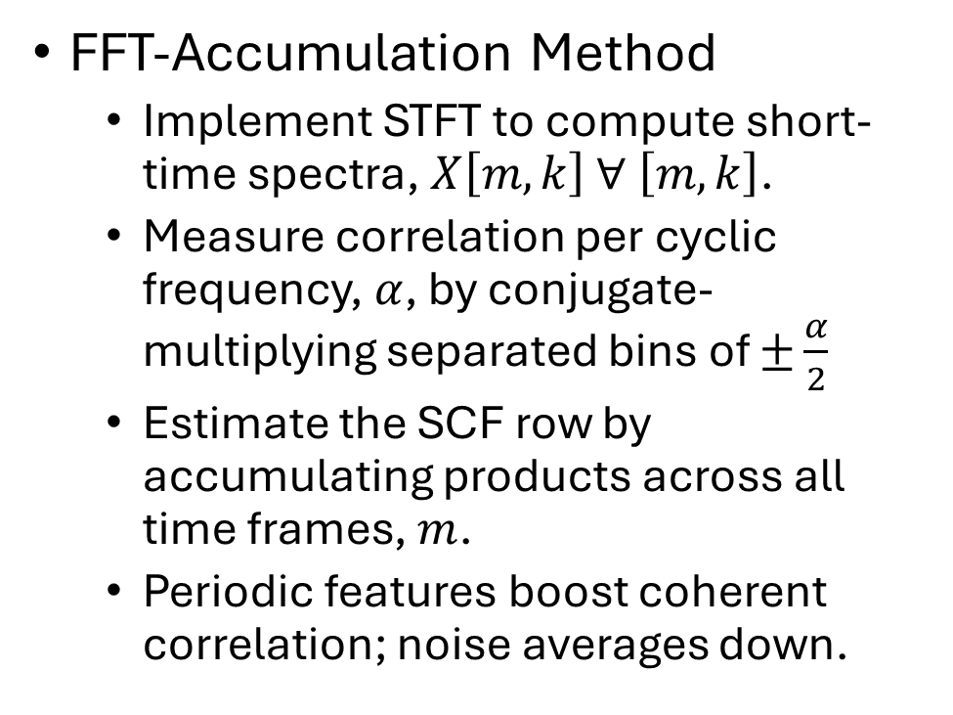

Estimate Spectral Correlation Function (SCF)
FFT-Accumulation Method
Implement STFT to compute short-time spectra, $X\left[m,k\right]$ $∀ \left[m,k\right]$.
Measure correlation per cyclic frequency, $α$, by conjugate-multiplying separated bins of $±\frac{α}{2}$
Estimate the SCF row by accumulating products across all time frames, $m$.
Periodic features boost coherent correlation; noise averages down.
1MHz DSSS chip rate
.4MHz OFDM $1/T_{s}$
Unused OFDM subcarriers

Slide 10
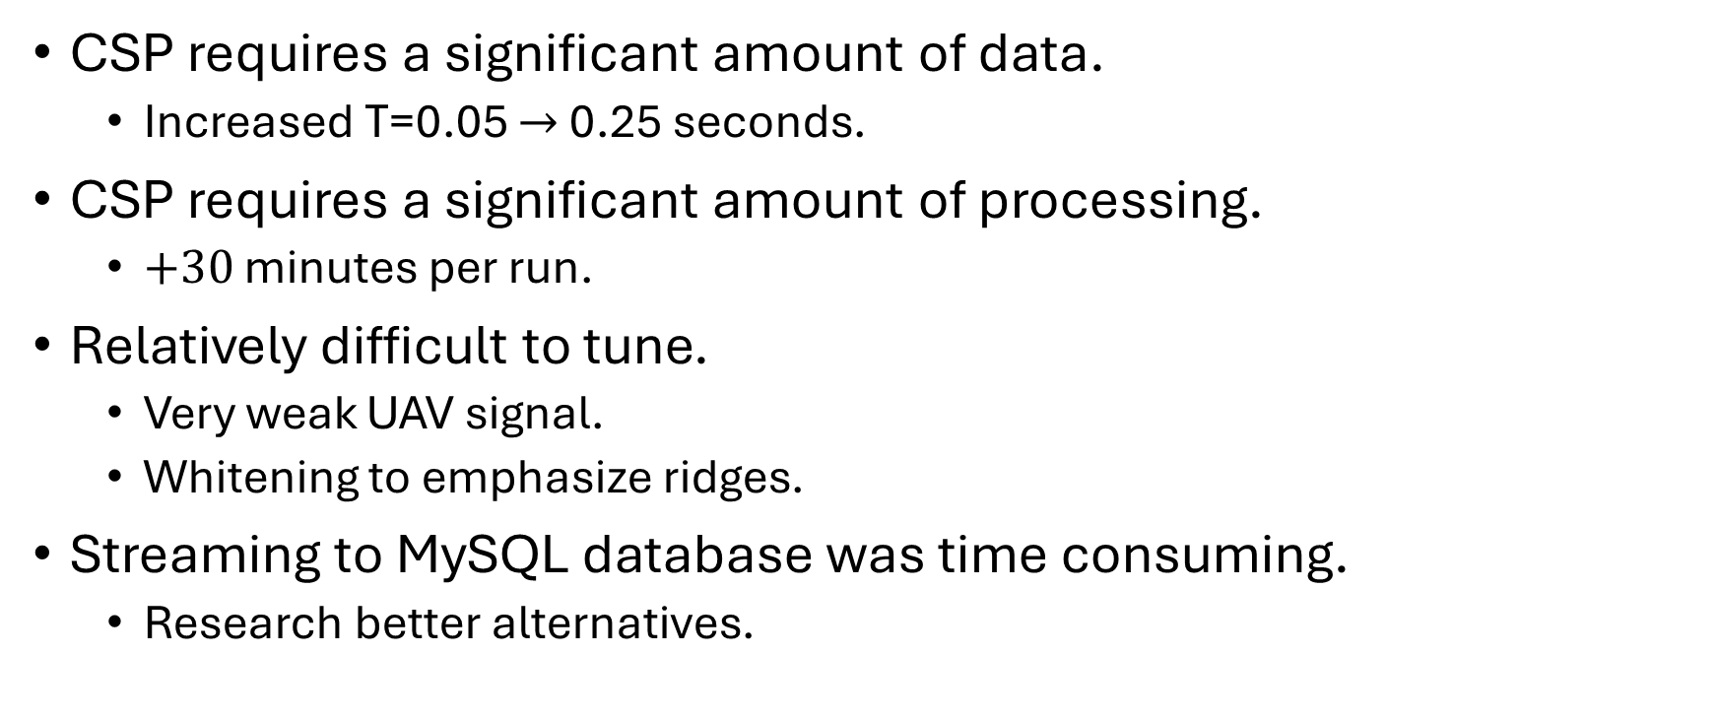
Observations
CSP requires a significant amount of data.
Increased T=0.05 $→$ 0.25 seconds.
CSP requires a significant amount of processing.
$+30$ minutes per run.
Relatively difficult to tune.
Very weak UAV signal.
Whitening to emphasize ridges.
Streaming to MySQL database was time consuming.
Research better alternatives.

Slide 11

With a little more time..
Stand-up a HPC environment.
Point to MySQL database
Host SCF / CAF processing .py

Slide 12
Questions?

